Slide 1

Market Research
Online and Private Tutor Markets

Slide 2
Online and Offline Education Market
Online preparation market
Offline preparation market/Private Tutoring
K12 education
Pre Primary Education
Market size and forecast

Slide 3
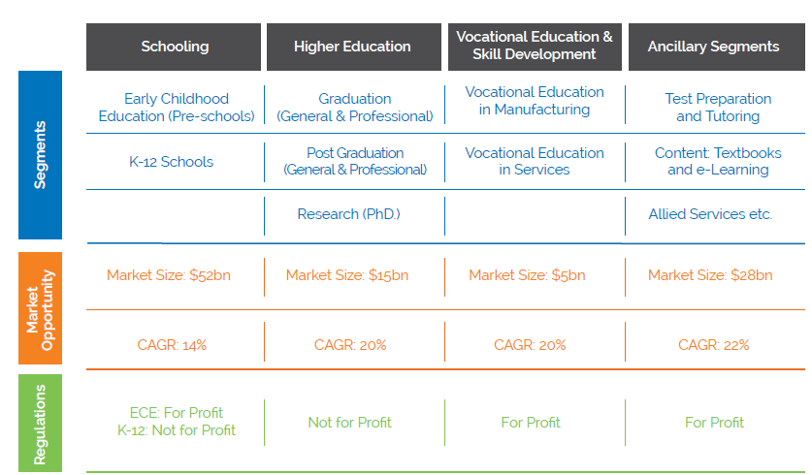
Education System in India(Projections 2020)

Slide 4
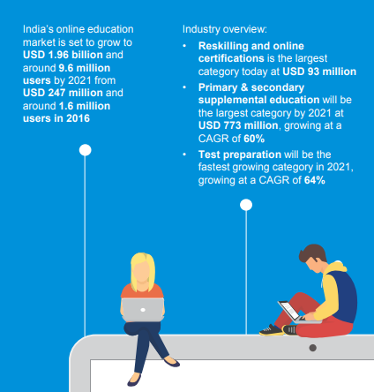
Online education Market in India
As per Ken Research’s report, during the period FY’ 2010 - FY’2015, the online test preparation market grew at an unprecedented CAGR (Compound Annual Growth Rate)of 17.8%. This is expected to outperform the overall test preparation market in the next 5 years.
As per KPMG’s report on online education market in India sites that the number of users and also the market size is expected to grow to USD 1.96 Billion by 2021.
https://assets.kpmg.com/content/dam/kpmg/in/pdf/2017/05/Online-Education-in-India-2021.pdf

Slide 5
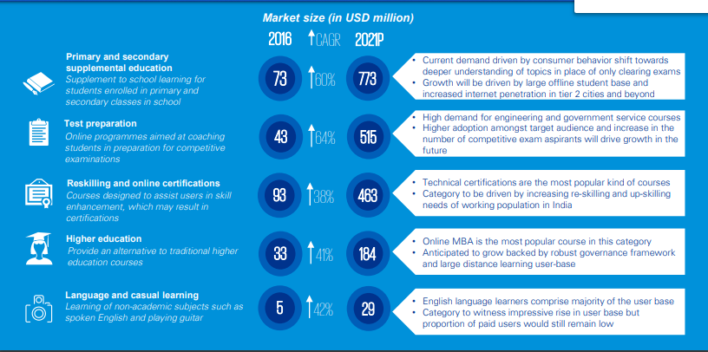
Online learning Projections for 2021 by KPMG

Slide 6
Offline Education or Private tutoring in India
Private tutoring is far more effective method of learning for most of the students, it gives more space and confidence to grow at your own pace.
The analysts forecast the global private tutoring market to grow at a CAGR of 6.76% during the period 2016-2020.
The market is expected to grow to $30 billion by 2020.
The private tutoring industry has emerged following the extensive standardization of the education sector.
This standardization essentially refers to the provision of examination preparation services to students to help them score well in entrance tests.

Slide 7
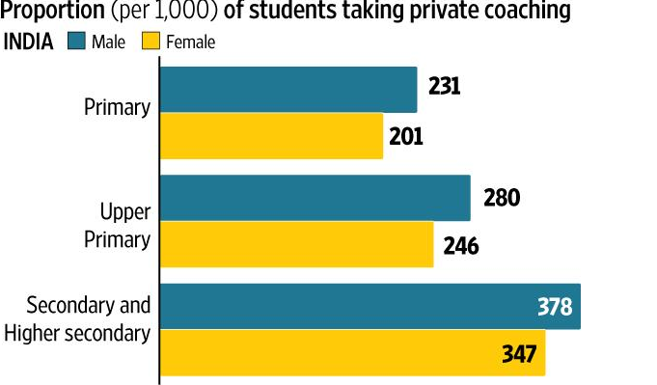
Primary and k-12 Education in India
Primary school kids ranging from class 1-6 generally go to private tutors in their locality.
It is estimated that one out of every four students take private tutoring. http://assocham.org/newsdetail.php?id=4050

Slide 8
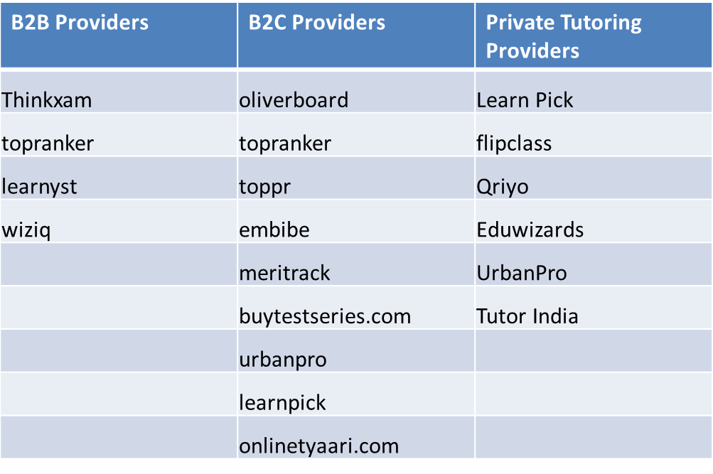
Providers
Notes:
GEM Learning, Octavesim

Slide 9
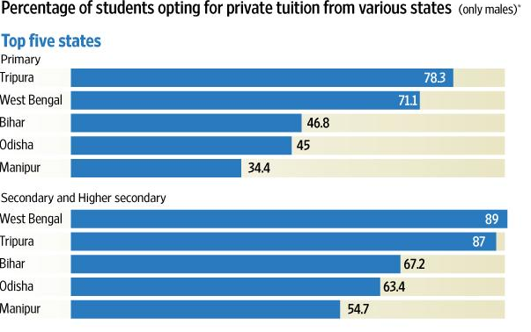
State wise Demographics 2017

Slide 10
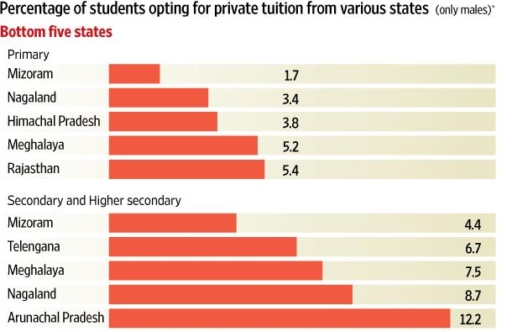
Bottom 5 states

Slide 11
Demand for Private Tutors
It is very much evident that one of four students take private tutoring to boost their learning.
In rural areas finding a private tutor who can provide quality education to the children is not easy. Since most of them juggle with multiple subjects.
The problem with this market segment is that,
Either the tutor does not have proper education or expertise in the subject or if they have expertise connecting to the students from different location is a problem.
Sometimes tutors or students availability is a problem.
Individual attention to each and every child is an issue in a private tutoring scenario where a group of children with different IQ/level of understanding is a major issue.
This problem can be overcome by hiring tutors offering recorded or live online classes, applications that offer LMS for better tracking metrics of the students.

Slide 12
Education Sector in GCC
Saudi Arabia has been the largest market for education services in the Gulf Cooperation Council (GCC) region
Strong government support over the past few years has led to the continuous growth of education sector by inviting private players to enter the space.
The three major organizations that oversee the operations of education market players in Saudi Arabia are the Ministry of Education, the Ministry of Higher Education, and the Technical and Vocational Training Corporation (TVTC).

Slide 13
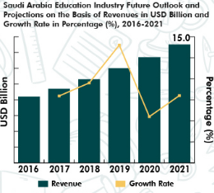
Online test preparation market
Saudi Arabia education industry is expected to register a CAGR of 12.3% during the period 2018-2020. Adoption of e-learning in higher education colleges contributed the majority share of 40.0% to the overall industry revenues in 2016 according to research.
The study noted that currently, Saudi Arabia holds the biggest share in the regional market and is expected to earn $237.1 million by 2023. Subesequently, the UAE market is expected to follow closely with a CAGR of 10.3 percent over the forecast year.

Slide 14
Online Test Preparation Providers
https://www.testprepkart.com
https://www.kaptestglobal.com/kceps/saudi-arabia
https://www.kaptestglobal.com/course/usmle-step-1-live-prep-saudi-arabia

Slide 15
Primary and k-12 in Saudi Arabia
The K-12 education market in GCC to grow at a CAGR of 4.54% during the period 2018-2022.
Providers of online and offline education
Al-Jazeera Academy
British International School of Jeddah
Dhuha International School
Dubai International Academy
GEMS Education
International School of London
Nadeen International School
New English School
Taaleem
The American International School of Muscat

Slide 16
Private Tutoring in GCC
It is estimated from a recent study that families of saudi spend SR752 for the year 2017 on private tutoring.
Riyadh spent the highest amount, or SR260 million, while Makkah region spent SR156 million. Baha had the lowest spending on tuition with SR2.6 million.
An article reports that people spend Dh1350 per hour for private tutors and tutors are making as much as Dh 13000 per day.
https://gulfnews.com/news/gulf/kuwait/private-tutors-make-up-to-dh13-000-a-day-in-kuwait-1.1342439

Slide 17
Private Tutoring Key Players of GCC
Private Tutor Providers in Saudi
University Tutor
My Private Tutor

Slide 18
Online and offline education Market
Adoption of e-learning in higher education colleges contributed the majority share of 40.0% to the overall industry revenues in 2016 according to research.
https://www.testprepkart.com
https://www.kaptestglobal.com/kceps/saudi-arabia
https://www.kaptestglobal.com/course/usmle-step-1-live-prep-saudi-arabia

Slide 19
Education Sector in China
Data from iResearch show that the revenue of China’s online education is expected to reach 543.4 billion Yuan in 2022, fuelled by these factors: users are more receptive to online education, users are more willing to pay for it; and online classes are more abundant.
The central government of china is also encouraging private education investments and it is expected to raise the GDP by 12.8% in 2020.
https://www.researchandmarkets.com/reports/4318804/china-online-education-industry-report-2016-2021

Slide 20
K-12 education in china
Data from iResearch indicate that online K-12 education, online higher education and vocational education will always be main part of online education market, taking up over 95.0% of online education market in China.
iResearch holds the opinion that although extracurricular training for K-12 education is in rigid demand, its market share is still quite small in the initial stage.

Slide 21
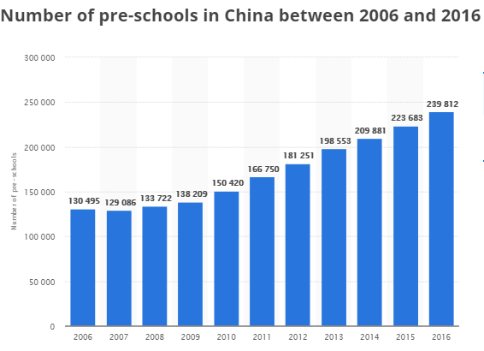
Education sector analysis
https://www.statista.com/topics/2090/education-in-china/
Number of preschools in China

Slide 22
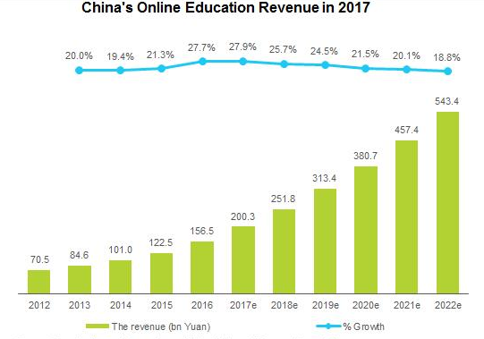
China’s online Education Revenue in 2017

Slide 23
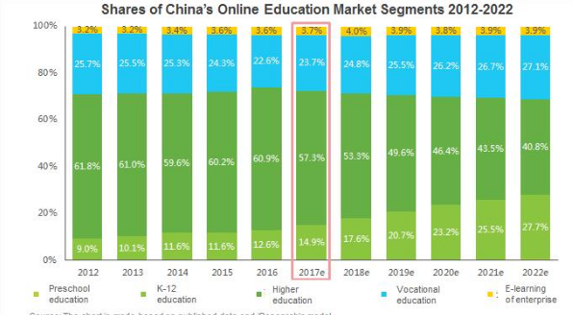
China’s Online Education Segments
http://www.iresearchchina.com/content/details7_40642.html

Slide 24
Growth of Internet users in China
With the growth of internet users (600 millions)in China having a positive linear trend, the online learning industry is expected to grow in the upcoming years.
It is also estimated that the number of internet users in China have surpassed US.
https://www.theguardian.com/technology/2009/jul/16/china-internet-more-users-us-population

Slide 25
Private Tutoring Market in China
The private tutoring market in China is highly fragmented due to the presence of several well diversified regional vendors.
Providers
Ambow Education
New Oriental
TAL Education
Xueda Education
Other prominent vendors in the private tutoring market in China include Juren Education Group, Manhattan Review, iTutorGroup, EF Education First, MandarinRocks, Web International English, Kaplan, Xiaozhan Jiaoyu, and Tutors in China.
https://www.technavio.com/report/china-k12-and-higher-education-private-tutoring-market-china-2017-2021

Slide 26
Private Tutoring Market in China
As a result, vendors are undergoing strategic alliances and spending significantly on marketing and advertising campaigns to brand their tutoring services and capture the interest of the upper-income strata of the Chinese households. The competitive environment of the market is likely to intensify further with increased service extensions, technological innovations, and M&A.
The after school tutoring market in China is expected to increase to 1082 yuan by 2021.
http://www.chinadaily.com.cn/business/2017-08/25/content_31084033.htm

Slide 27
Top Providers of online learning in China
1. 51 Talk
Koolearn
XS Teach
Yuanfudao
Lao-A E-Commerce Platform
Crazy Teacher
ABC360
Sanhaowang
XDL
Zhiyou Education

Slide 28
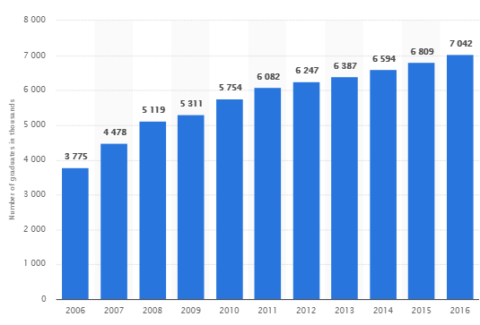
Vocational Education
China has the world's largest vocational education system, with 12,300 colleges offering about 100,000 majors. Together they have almost 27 million students, who will become the backbone of modern manufacturing, strategic emerging and modern service industries.
With number of universities in China increasing steadily, it is expected that by 2020 ,195 million graduates will complete their graduation, it is estimated that only 26% of students secured jobs after graduation.

Slide 29
Online and Offline English Learning in China
English is required for domestic entrance exams and graduate studies.
English language skills are tested in many job interviews in china and hence many students and professionals undergo english training sessions either online or offline.

Slide 30
Key Providers of English Learning
Berlitz
ChinaEDU
Disney English
EF Education First
iTutorGroup
New Oriental Education & Technology Group
Pearson ELT
Sprout4Future
TAL Education Group
Xueda Education Group

Slide 31
Online and offline education in Japan
Japan represented the eighth highest population of students studying in the United States during the 2016/2017 school year. Japanese students studying in higher learning institutions in the United States accounted for 18,780 students, and contributed more than USD 636 million to the U.S. economy through their expenditures on tuition and living expenses. https://data.oecd.org/japan.htm#profile-education

Slide 32
Private Tutoring in Japan
It is estimated that a private english tutor earns
200,000 – 600,000 yen per month.
https://www.gooverseas.com/blog/salary-expectations-for-teaching-in-japan

Slide 33
Online education Sector in Singapore
The Ministry of Education (MoE) in Singapore has launched a pilot for a new online learning portal, called the Singapore Student Learning Space (SLS). Teachers and students from 62 primary and secondary schools are participating in the pilot.
Also in Singapore Universities offer online master degrees for students,
https://www.distancelearningportal.com/study-options-a/masters/133/singapore.html

Slide 34
Key Providers of Online learning in Singapore
Antoree
Coursepad
eUniversity Pte Ltd
Gnowbe
Inchone
Knowledge Platform (Singapore,India,Pakistan and China)
KooBits Pte Ltd
Kydon Learning
Marshall Cavendish
Phoenix OneSoft Singapore
Playware Studios
Skillslagoon
Teamie
Three Learning
Wizlearn Technologies
https://www.businesswire.com/news/home/20160914005765/en/Singapore-E-Learning-Market-Forecast-2020---Increasing

Slide 35
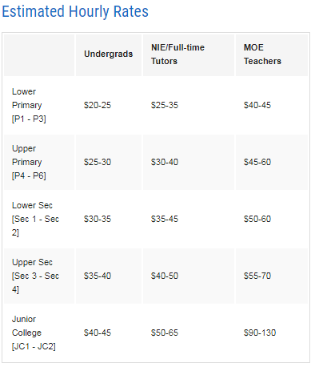
Private Tutoring Market in Singapore
According to Singapore’s household expenditure survey, private tuition in Singapore is a SGD$1.1 billion (US$768 million) industry (for a nation with a population of about 5.6 million), almost double the amount households spent in 2005 ($650 million). How does that look at the household level?
Thirty-four percent of those with children currently in tuition spend between $500 and $1,000 per month per child, while 16% spend up to $2,000.

Slide 36
Private Tutor Providers
Nearby Tutors
University Tutors
Epigami
Smiletutor
Nanyang Academics Tutor
Hace Home Tutor
List of all available tutoring agencies or private tutors,
https://www.yelp.com.sg/search?find_loc=Singapore&start=0&cflt=privatetutors

Slide 37
Primary and k-12 private tutor statistics
There are 250k students who are under 7 years enrolled (as on 2015) for primary education in Singapore.
There are 370k students who are under 16 years of age enrolled for secondary education.
Also a part of the families income goes into online offline learning.

Slide 38
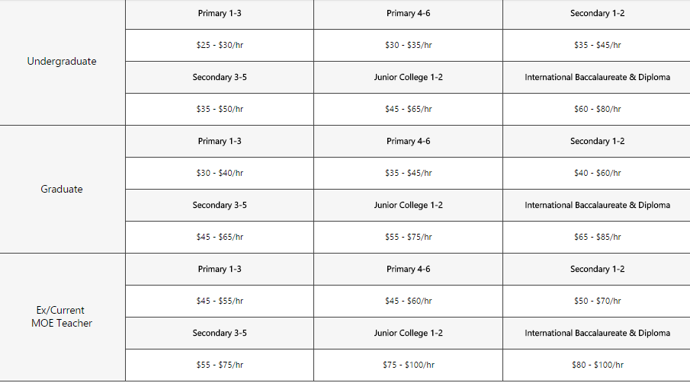
Hourly pay estimates of tutors in Singapore

Slide 39
Online and offline education in Saudi
Saudi Arabia e-learning industry has shown an impressive growth rate in 2016 owing to more number of foreign players entering the market and offering innovative technology services to cater the growing demand of the population.
The e-learning market is expected to raise to USD431Million by 2021.This is due to rapid increase of internet users in the kingdom according to a research.
https://www.kenresearch.com/blog/2018/01/saudi-arabia-e-learning-industry-is-expected-to-reach-over-usd-430-million-by-2021-ken-research/
Offline or Private education in Saudi ,
http://saudigazette.com.sa/article/525234/Opinion/Local-Viewpoint/SR752-million-for-private-tuition

Slide 40
Online and offline education in Kuwait
Kuwait’s private education/Offline education market for k-12 is expected to grow from $2 billion by 2023.
https://www.pressreader.com/kuwait/kuwait-times/20180620/281655370794465
OnThe goal of Kuwait's "e-education" plan is to deploy Mobile Learning in all schools by 2013. The program deployed learning technology and digital content in 2011 starting with high schools. In 2012, the government began rolling out the Mobile Learning products in the middle schools, elementary schools, and kindergartens, respectively.
http://www.ambientinsight.com/Resources/Documents/AmbientInsight-2012-2017-Middle-East-Mobile-Learning-Market-Abstract.pdf

Slide 41
Online and offline education in Qatar
Private tutoring agencies are thriving in Qatar with a fee range of QR5600 to QR11700.
https://www.thepeninsulaqatar.com/article/02/04/2017/Demand-high-for-private-tuition-despite-curbs
http://www.qatar-tribune.com/news-details/id/126405
Qatar private tutoring market is expected to grow $2.4bn by 2023.

Slide 42
Online and offline education in Oman
Oman is the top performer in e -learning terms for the rankings that cover the Middle East. Oman has the highest growth rate in the region at 19.6, followed by Lebanon (16.0 percent), Turkey (12.9 percent), Kuwait (12.6 percent) and Qatar (11.3 percent). This is mainly because the government of Oman is interested in issues relating to education and computer literacy and, consequently, is investing heavily in the sector.
http://www.globaleducationmagazine.com/oman-destination-e-learning/

Slide 43
Online and offline education in Bahrain
Bahrain’s private school market is smaller than other GCC markets, given its smaller population, but it has the potential to grow from $0.4 billion in 2015 to $0.7 billion in 2023.
Bahrain is a highly fragmented market, with no large-scale operators. There is a need for high-quality private international schools with low- to mid-range fees. By encouraging healthy competition, the country can benefit from its investor-friendly environment with fewer barriers to entry than the rest of the GCC region.
http://www.tradearabia.com/news/EDU_340466.html
Bharain’s online learning market is emerging. University of Bahrain has established online learning portal way back in 2004.There are other providers of online learning in Bahrain where the course fee ranges between BHD 1000 to BHD 25000.
https://courses.laimoon.com/bahrain/teaching-and-education/?price_from=1000&price_to=5000

Slide 44
Online and offline learning in UAE
Geographically, online education & e-learning market of Kingdom of Saudi Arabia is holding the largest market share and is expected to garner USD 237.1 Million by 2023.
UAE is anticipated to hold second position and to grow at a CAGR of 10.3% over the forecast period.
UAE online education and e-learning market is expected to experience high growth on the back of increasing government investment to digitize the education sector.
Apart from this, the demand for online education & e-learning is rising in UAE on account of heavy adoption and positive student attitude towards e-learning.
The UAE itself also receives the largest foreign direct investment (FDI) after Turkey in all west Asia, with $13 billion attracted in 2015 alone.
https://www.docebo.com/blog/elearning-middle-east-growing/
Private tutoring market : According to a new report today by The Boston Consulting Group (BCG), entitled ‘Where to Invest Now in the GCC Private Education’, the UAE’s private K-12 education market valued at $4.4 billion in 2017 is poised to grow to $7.1 billion by 2023.
https://www.menaherald.com/en/business/education/uae%E2%80%99s-private-k-12-education-market-will-grow-approximately-40-next-5-years

Slide 45
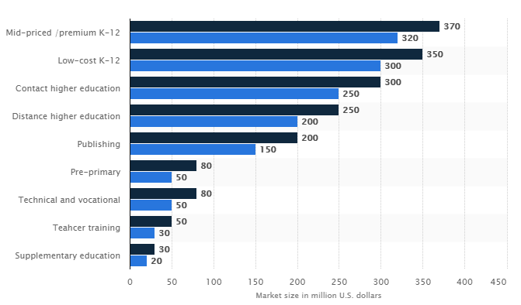
Education sector in Africa 2017

Slide 46
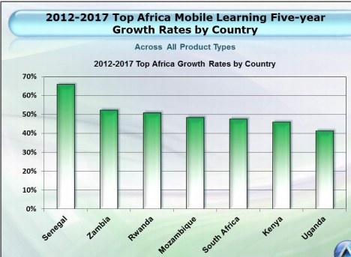
Online Education in Africa
Sector experts in Sub-Saharan Africa have noted with a lot of interest that online learning is a rapidly expanding field that has the potential to impact the sector greatly.
Internet users have rapidly increased in the continent owing to increased mobile learners.
MOOC has a special place in enabling education in Africa as it enables geographically dispersed students to take their courses.
http://www.ambientinsight.com/resources/documents/ambientinsight-2012-2017-africa-mobile-learning-market-abstract.pdf
https://www.prnewswire.com/news-releases/africa-e-learning-market-reached-a-value-of-more-than-us-600-million-in-2016-exhibiting-a-cagr-of-around-15-during-2009-2016-654693463.html

Slide 47
K-12 in Africa
https://ssir.org/articles/entry/is_private_education_in_africa_the_solution_to_failing_e
sub-Saharan Africa is home to more than half the world’s out-of-school children, it receives only about a quarter of global education aid.
The region’s education systems continue to face three basic issues: access, quality, and relevance.
One billion children in sub-Saharan Africa will need education in the coming three decades, but with up to 40 percent of children not meeting basic literacy and numeracy targets, sub-Saharan Africa is the worst-performing region globally for learning outcomes.
Furthermore, by 2025, Africa will surpass the rest of the world combined in the number of people joining the labour force (ages 15-64). Yet even now, sub-Saharan Africa’s education systems cannot accommodate labour force needs.

Slide 48
Access, Quality and Relevance
Three main factors affecting education sector in Africa are access ,quality and relevance of education.
There is a huge demographic shift in Africa with a median age of population being 20 and the country is expected to produce 18 million high productivity job till 2035.
11% households will jump from earning only $5000 per year to a range between $5000 - $25000 per year.
It is estimated that 445 million unique mobile subscribers in Sub Saharan Africa.
All these factors will contribute to transforming education in Africa by providing access to education via online medium like learning portals/apps, the demography data of Africa shows that 40% of its population comes from cities which demands quality of education to be able to have a skilled workforce for better employability.
https://edafricareport.caeruscapital.co/thebusinessofeducationinafrica.pdf

Slide 49
Private Tutoring Providers Africa
First Tutors
SA Tutors
Gutsy Tutoring
Gumtree
Education Matters
Tuteria

Slide 50
Europe Online learning
http://franchise.tutordoctor.co.uk/research-tutor-doctor/how-big-is-the-private-tutoring-market-in-uk/
Technavio’s market research analyst predicts the e-learning market in Europe to grow at a CAGR of around 12% during the forecast period. The extensive adoption of blended learning in universities is the key driver for the growth of the e-learning market in Europe. To spur the prospects for market growth in this region, many schools have started providing online repositories, digital courseware, and learning management tools for content development, course management, and student portals. In Western Europe, the majority of the institutions have started offering online courses, with no chargeable fee. The advent of such online courses will aid market in Europe during the predicted period. in the growth of the e-learning m

Slide 51
Private Tutoring in Europe
http://www.moneybags.co.za/article/the-cost-of-hiring-a-tutor/
According to a study carried out in 2016, approximately one in four children receive home tuition, nationwide. In London, as opposed to Edinburg tutors say, this figure is significantly higher, with 42% of students receiving help from a personal teacher. The proportion of students receiving home tuition has increased by over a third in the last decade. Overall in the UK, a quarter of all 11-16 year old received private tution in 2017.
Nearly half (43%) of teachers working at state schools have given private lessons at some point in their careers.
On average, a private lesson costs £20.60, though this varies considerably from one region or city to another.

Slide 52
Europe Online learning Providers
The e-learning market in Europe is highly competitive due to the presence of numerous large and medium vendors that account for substantial market shares. The market is growing at a rapid pace and is opening a wide range of options for vendors that offer various kinds of products and services.
The leading vendors in the LMS market are -
Adobe systems
Blackboard
Docebo
SAP
Other prominent vendors in the market include Aptara, City and Guilds Group, Edmodo, Educomp, Haiku Learning, N2N Services, Saba Software, Schoology, and Tata Interactive Systems.

Slide 53
Online Education in North America
North America To Hold The Largest Share In 2018
Eight universities in the top 10 world’s best universities belong to North America. These institutions employ the usage of online learning programs such as MOOCs and distance learning programs, which further bolster the market for smart learning.
The ConnectED initiative implemented has an aim of connecting 99% of the American students to high-speed broadband and internet facilities.
American K-12 schools have spent about USD 9.94 billion on education technology, and further growth is expected in the market owing to various factors, such as increased demand for interactive learning, better education content, etc. Los Angeles Unified school district has aimed at equipping 640,000 students in its district with iPad tablets, at a total financial cost 1 billion to be invested in the initiative.
San Antonio Independent School district has distributed Dell Latitude 10 tablets to about 33 of the total 90 libraries with e-book capability to facilitate the learning activity.

Slide 54
Private Tutoring Market in USA
The analysts forecast the private tutoring market in the US to grow at a CAGR of 7.09% during the period 2018-2022.
A private tutor charge per hour ranges between $10 - $100 depending on the expertise and the type of service they offer.
For k-12 private tutoring there are different providers online and offline and they charge for primary school and secondary school kids differently.

Slide 55
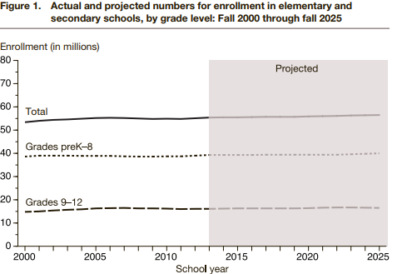
K-12 education in USA
A research paper shows actual and predicated number of enrollments of students in the USA.
It is expected to increase a percentage or two in the upcoming years.
An not for profit organization named OLC-Online Learning Consortium helps in regulating online, private and public institutes courses and contents.

Slide 56
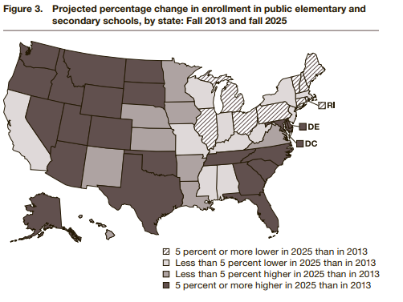
Enrollments k-12
The map view shows enrollment analysis done for different parts of the United States and projected enrollments for 2025 considering 2013 status of enrollments as base.
The report talks in depth about student enrollment , teacher hires and other related factors supporting primary and secondary education in the US.

Slide 57
Test Preparation Market in USA
The Test Preparation Market in the US to grow at a CAGR of 10.16% during the period 2016-2020.
Test preparation providers make supplementary educational materials, mock tests, and guides available in classroom-based or online learning modes.
These services help students prepare for various university and high school level exams, such as SAT and ACT, as well as certification exams, such as Law School Admission Test (LSAT) and CPA. The quality assistance in preparation for various tests help students attain academic goals.

Slide 58
Test Preparation Providers
ACT, Inc.
American Council on Education
Association of American Medical Colleges
College Board
Educational Testing Service
Graduate Management Admission Council
Law School Admission Council
A detailed list of providers and subscribers are available in the link below,
https://www.prnewswire.com/news-releases/united-states-test-preparation-market-to-2021---increasing-competition-from-free-substitutes-300509677.html

Slide 59
References
https://edafricareport.caeruscapital.co/thebusinessofeducationinafrica.pdf
http://www.ardentadvisory.com/files/GCC-Education-Sector-Report.pdf
https://www.elucidat.com/blog/elearning-trends-2018/
https://www.docebo.com/landing/contactform/elearning-market-trends-and-forecast-2014-2016-docebo-report.pdf
https://www.learninglight.com/elearning-predictions/

Slide 60
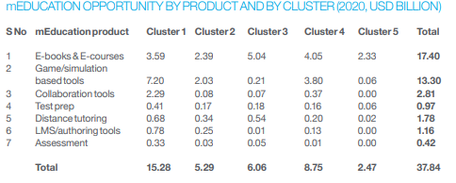
McKinsey Cluster analysis - Overview
McKinsey conducted market research in education sector for 45 countries and have formed clusters depending on several factors like population,spend on education and other geographic features of the country and formed 5 clusters.

Slide 61
Cluster 1 (US andUK):Grouped separately as they are first movers in Online Education adoption.
Cluster2(JapanandSouthKorea):Whiletheyarealsofirstmovers,theyarehaveahigher shareof supplementary spend.
Cluster3(India,ChinaandBrazil):NascentmEducationmarkets thatarelikelytoenjoysignificantly higher economic growth than other developing regions.
Cluster4(Otherdevelopedcountries):NascentmEducationmarketswithhighper capitaincomesand technology readiness in terms of devices and high-speed network penetration.

Slide 62
References
https://www.singstat.gov.sg/-/media/files/publications/reference/yearbook_2017/yos2017.pdf
https://qz.com/860356/pisa-singapores-competitive-private-tuition-system-helps-students-ace-the-worlds-biggest-education-test/
https://www.marketresearch.com/Public-Sector-c93/Education-c233/E-Learning-c812/
https://eclass.teicrete.gr/modules/document/file.php/TP271/Additional%20material/docebo-elearning-trends-report-2017.pdf
http://www.tojet.net/articles/v15i2/1526.pdf
https://economictimes.indiatimes.com/industry/services/education/online-education-will-be-a-2-bn-industry-in-india-by-2021-google-kpmg/articleshow/58913744.cms

